Slide 1







Classroom introduction
An introduction to active citizenship and food waste recycling
Age: 5 to 11
Time: Approx. 25 minutes + homework
Subject: Humanities, Science & Technology, Mathematics & Numeracy

Slide 2





About The Mighty Food Waste Mission
Teachers’ notes
    By using these curriculum-linked Mighty Food Waste Mission resources, you are helping your pupils understand the importance of reducing food waste and recycling what can't be eaten to create renewable energy, and how it can impact
    on Wales and the planet.
    This programme has been developed
    in partnership with EVERFI and a panel
    of practising teachers.
​Whilst Wales is one of the world’s top recycling nations, a quarter
of the average rubbish bin is still made up of food waste – equivalent to filling 3,300 double-decker buses every year. Shockingly, a massive 80% of that could have been eaten.
The Mighty Food Waste Mission is calling on children aged 5-11 to help create a more sustainable future where we waste less and recycle more.
It will teach pupils how every bit of food we buy has value and how we can save money and protect our planet by making the most of it whilst recycling what can't be eaten to create energy.
    Pupils can enter the competition by creating a recipe poster showing how we can use
    up commonly wasted foods. Prizes include a personalised food hamper for the family and books for the school.
    The VALUE of preventing food waste
    Throwing away food that could have been eaten costs the average family in Wales £83 per month,
    or £49 for a household of 2 people. Through the Mission, pupils will learn what items of food are most commonly wasted and how they can be used up
    in simple family dishes to avoid wasting food
    and money.
    The VALUE of recycling food waste
    If you can’t eat it, recycle it! In Wales, our food waste is recycled into renewable energy. Pupils will discover that "inedible" food – such as banana peels, bones and eggshells – should go in the caddy and not the rubbish bin to create energy to power their homes and devices.
    You can find everything you need to join
    the Mighty Food Waste Mission on the Wales Recycles website:
    www.walesrecycles.org.uk/schools

Slide 3




Why take part?
Teachers’ notes
The Mighty Food Waste Mission is part of Wales Recycles’ national ‘Be Mighty. Recycle’ campaign, contributing to Welsh Government’s goal of becoming a zero-waste nation by 2050 and boosting Wales to no.1 in the world for recycling. Join the Mission to help create a greener, cleaner Wales for future generations.
The activities and lessons are aligned with the Curriculum of Wales
and your pupils’ work can be used as part of your Eco-Schools evidence.
From 6 April 2024, it will become law for all workplaces, including your school, to separate their waste for recycling. This will help Wales recycle even more and help tackle climate change. By supporting the Mighty Food Waste Mission you will be helping your pupils understand how important recycling our waste is, and how it can impact on Wales and the planet.

Slide 4
Lesson overview
Teachers’ notes
​Learning objective:
Every bit of the food we buy has value: we need to make the most of it!
Activity |  | Overview |  | Slides |  | Timings
Starter activity​ |  | What can we do with Arthur? |  | 8–12 |  | 5 mins​
Introduction |  | Why food waste matters |  | 13–20 |  | 5 mins​
Activity 1 |  | Saving edible food |  | 21–23 |  | 3 mins​
Activity 2 |  | Recycling inedible food |  | 24–28 |  | 7 mins
Plenary |  | Making a difference |  | 29–32 |  | 5 mins
Competition intro |  | About the competition homework (create a recipe) |  | 33–37 |  | 5 mins+
The Be Mighty recipe inspiration gallery |  | Showcase ways that everyday recipes can be updated based on what food might be at risk of being wasted |  | 38–41 |  | 5 mins
After your pupils have completed the competition homework, as a class, review the recipes they have created (see slides 42-43)

Slide 5





How it works
Teachers’ notes
We provide all the resources you need to complete the
Mighty Food Waste Mission in as little as an hour!
Class introduction
Deliver a session informing pupils about the issue of food waste and how they, as engaged citizens, can help us all to get the most value out of our food.
Time: 25 minutes​+
Suitability: Assembly or lesson
Resources:​ This slide deck
Competition homework
Create a recipe poster to help people to make the most of their food, using up what is edible and recycling what is inedible. There are prizes for the most inspiring recipes!
Time: 30 minutes​+
Suitability: Homework (with a short follow-up session in class, or complete in class)
Resources:​ Mighty Food Waste Mission activity sheet: Recipes to the rescue!
Classroom follow-up session
Help your pupils take their learning further!
Go to www.walesrecycles.org.uk/schools to:
      Download our digital flyer for your
      school newsletter.
      Bring your recipes into class so you can share your ideas and inspire each other!​
      You can also take the learning further with
      the additional curriculum-linked resources.
Extend your pupils’ learning
We have fun additional science, English and maths challenges on our website: www.walesrecycles.org.uk/schools

Slide 6

Curriculum links Wales
Teachers’ notes
Humanities
    Enquiry, exploration and investigation inspire curiosity about
    the world, its past, present and future.
      I have actively engaged with a range of stimuli, and had opportunities
      to participate in enquiries, both collaboratively and independently.
    Our natural world is diverse and dynamic, influenced by processes and human actions.
      I can describe and give simple explanations about the impact of human actions on the natural world in the past and present.
    Informed, self-aware citizens engage with the challenges and opportunities that face humanity and are able to take considered and ethical action.
      I can understand the consequences of my actions and the actions of others, and how these affect my locality and Wales, as well as the wider world.
Mathematics and Numeracy​
    The number system is used to represent and compare relationships between numbers and quantities.​
      I can use the four arithmetic operations confidently, efficiently and accurately with integers and decimals.​
      I can fluently recall multiplication facts up to at least 10 x 10 and use these to derive related facts.​
Languages, Literacy and Communication​
    Expressing ourselves through languages is key to communication.​
      I can recognise the appropriate language for different audiences and purposes, varying my expression, vocabulary and tone
      to engage the audience.​
      I can adapt and manipulate language and make appropriate choices about vocabulary, idiomatic language and syntax in order
      to express – myself with fluency and clarity.​
Health and wellbeing
    Developing physical health and well-being had lifelong benefits
      I can explain the importance of a balanced diet and nutrition and
      the impact my choices have on my physical health and well-being.
      I can plan and prepare basic, nutritious meals.

Slide 7
Eco-Schools Action Plan (2023–24)
Teachers’ notes
If your school is taking part in
Eco-Schools, you can record your participation in the Mighty Food Waste Mission in your
Eco-Schools Action Plan.
    This will help ensure that your learning is transformed into action, and that positive change
    is lasting. It doesn’t matter if you aren’t the eco‑coordinator; it’s a whole school programme.
    By surveying or measuring before you take action, you can show just how much of a positive impact you can make and really help Wales to become
    the best in the World.
    These slides are editable so that you can adapt the content
    as necessary to meet the needs of your school's curriculum.
Target |  | Action |  | Who’s responsible |  | Cost |  | Timescale |  | How will we measure progress? (Monitoring)
Reduce food going into the bin at home |  | Set the Be Mighty homework Include information about where families can get food waste bins in the school newsletter |  | Class teachers School admin staff |  | No cost |  | by end of April 2024 |  | Survey families about their food waste-related knowledge and behaviour
Reduce food waste at school |  | Investigate and record how much food is wasted each day and why Use findings to develop and implement waste reduction activities |  | Eco committee Eco committee and lunch staff Whole school |  | No cost |  | by end of Spring term |  | Weigh the food waste each day for a week before implementing any changes Weigh again after your changes to see how much it has reduced

Slide 8
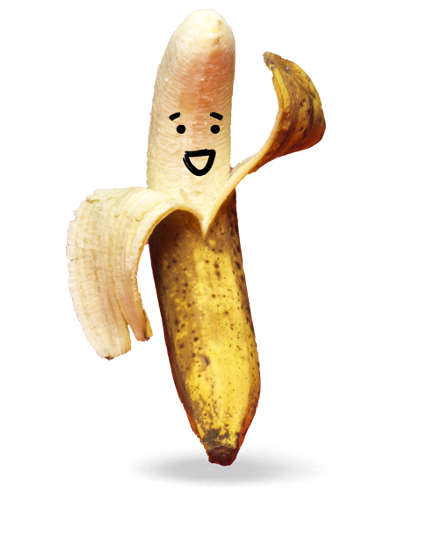


Slide 9

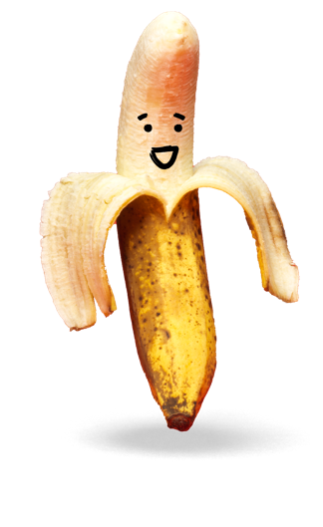
Arthur is a banana
Arthur spent almost a year growing from a little bulb to an impressive fruit in Costa Rica, Central America.
Being used to a tropical climate,
it was a bit of a shock when he was packed into a refrigerated ship bound for Wales – it took 10 whole days
to get there!
He was excited to experience life on
a supermarket shelf, and more excited still when the Llewellyn's family bought him for the bargain price of 20p.
They gave him pride of place in
their fruit bowl.
He looked forward to the day on which he would fulfil his destiny: sharing his delicious, vitamin-packed goodness with one of the Llewellyns!
As the days rolled on, Arthur began to lose hope, getting mushier every day. Finally, one rainy Tuesday, Sian Llewellyn picked him up. Finally!
Had his moment come?
“What shall we do with this banana?’ said Sian, wrinkling her nose.
“It’s a bit mushy!”
Wounded, Arthur held his breath. What would become of him?
Notes:
Starter activity – 5 mins (slide 1 of 4)
Read the story on the slide aloud.
Then, pose the questions on the following two slides.

Slide 10
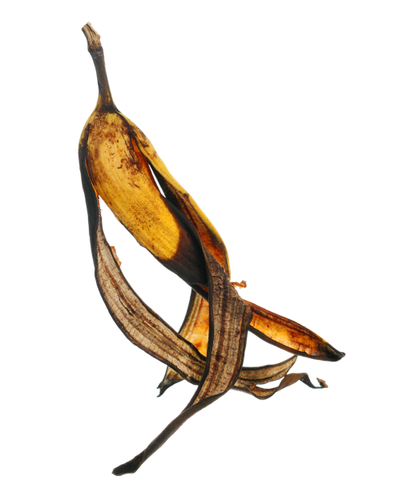



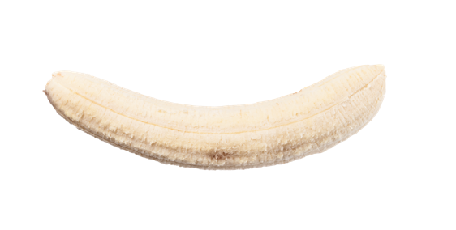
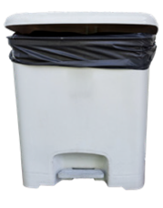

Sian has a choice
What can she do with Arthur?
Think about
the fruit and
the peel!
Remember:
food waste
should not go in
the rubbish bin.
Don’t feed the bin!
Notes:
Starter activity – 5 mins (slide 2 of 4)
Ask the question on the slide.
Take some suggestions from pupils for the answers.
Then, click to reveal the pictures showing the answers on the next slide.

Slide 11
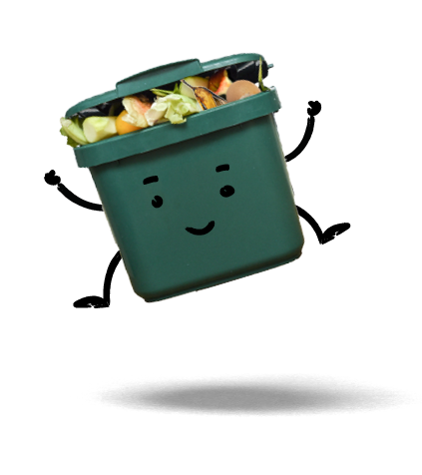




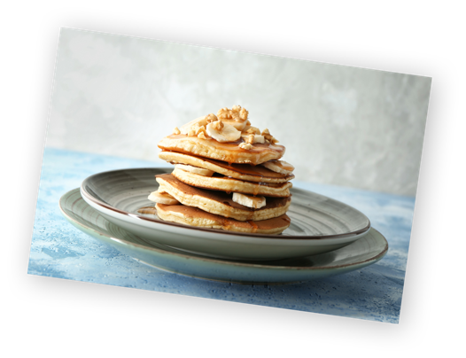
Sian has a choice
What can she do with Arthur?
Notes:
Starter activity – 5 mins (slide 3 of 4)
Highlight that food waste should always go in the food waste caddy and never the rubbish bin.
Support: Highlight that the picture shows a food waste caddy. All pupils should have one of these at home to put their food waste in. Ask pupils if they recognise the caddy.
Answer: The Llewellyn’s could eat Arthur anyway, even though he is a bit brown and squishy, or put him into banana pancakes. They should recycle his peel in their food waste caddy.

Slide 12
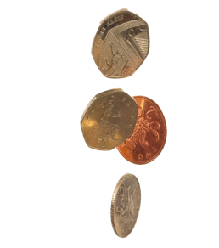




What is the impact of Sian’s choice?
Notes:
Starter activity – 5 mins (slide 4 of 4)
Ask the question on the slide.
Take some suggestions from pupils for the answers.
Then, click to reveal the pictures showing the answers.
Answers:
The peel:
Food is expensive, and so the Llewellyn’s will have less money if they waste food. They can save money by avoiding waste.
Growing and transporting food has an impact on the environment – if we waste food, this impact will be bigger.
Banana skin:
Putting it in a caddy is the best thing that you can do with it for the environment – it can generate green, renewable energy for our homes.

Slide 13
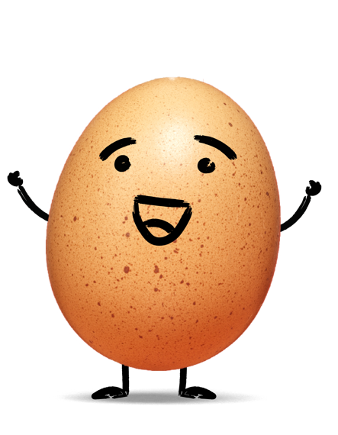


Slide 14
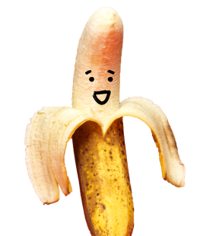
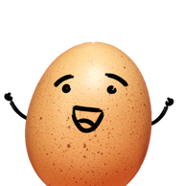
What are we learning?
Introduction
Every bit of the food we buy has value:
we need to make the most of it!
I can: ​
explain that "edible food" is food that can be eaten, and that we can save money by not wasting any edible food
give some examples of "inedible food waste" (food that can’t be eaten)
describe how inedible food waste is used to generate renewable energy.
Notes:
Introduction – 5 mins (slide 1 of 7)
Read the learning objectives and outcomes aloud.

Slide 15

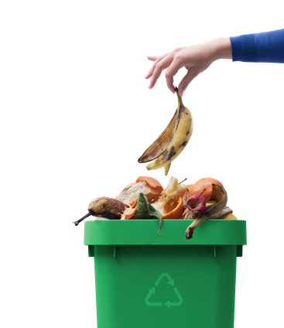

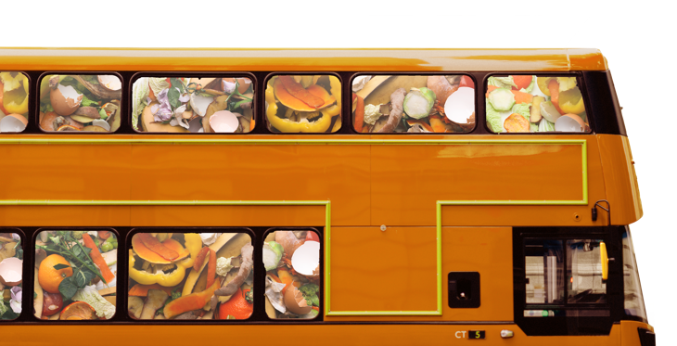
Join the Mighty
Food Waste Mission!
Introduction
Wales is leading the way in recycling – we are the third top recycling nation in the world!
But there is a long way to go to achieve the Welsh government’s ambitious target of becoming
a zero-waste nation.
Food waste is where YOU
can make the mightiest difference and help get
Wales to number 1!
And you may save some
money too! ​
We could fill 3,300 double decker
buses with the food waste that was
thrown away in Wales last year.
83% of this could have been eaten
and the rest could be turned into
green energy to power our homes!
Notes:
Introduction – 5 mins (slide 2 of 7)
Share the information on the slide.
Ask pupils what they think of the statistics?
Are they surprised by any of the numbers?

Slide 16


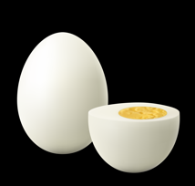


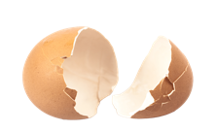
Let’s make the most of our food!
Introduction
Every bit of the food we buy has value – when we throw it in the rubbish bin, we waste that value.
When we throw away edible food, we throw away money!
When we throw away inedible food (like eggshells or banana peels), we throw away the chance to turn it into renewable energy!
Get the most value
from your food
Yes
No
Notes:
Introduction – 5 mins (slide 3 of 7)
Highlight that all food, whether edible or inedible, has value.
Use the decision tree to show that all edible food should be eaten, and all inedible food should be recycled.
Support: Define the key terminology:
Edible: suitable to be eaten, e.g. the banana inside the skin
Inedible: not suitable for eating, e.g. banana peel

Slide 17



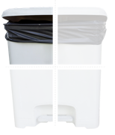
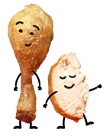

Why food waste matters
Introduction Option 1
Amount of waste in our rubbish bins that is food waste.
Food waste that should go in the rubbish bin?
Cost of throwing away edible food to the average Welsh household each month.
Number of recycled banana peels to charge a tablet.
Want to find out more about the power of food waste? Try our fun Maths Mission!
Notes:
Introduction Option 1 – 5 mins (slide 4 of 7)
This slide is most suitable for Progression Step 2 pupils. If working with Progression Step 3 pupils, move to slide 19.
Ask students to work out each mental maths sum to answer each question.
Delivery note: If delivering as an assembly, ask for volunteers to answer. If delivering this session in class, ask pupils to work on them individually.
Click to reveal the answers.

Slide 18

Why food waste matters
Introduction Option 1
Amount of waste in our rubbish bins that is food waste.
Food waste that should go in the rubbish bin?
Cost of throwing away edible food to the average Welsh household each month.
What could you do with this money?
Number of recycled banana peels to charge a tablet.
Want to find out more about the power of food waste? Try our fun Maths Mission!
Notes:
Introduction Option 1 – 5 mins (slide 5 of 7)
This slide is most suitable for Progression Step 2 pupils. If working with Progression Step 3 pupils, move to slide 18.
Answers: ¼, 0, £49, 3.5
Discuss the statements on the slide. Highlight that food waste should never go in the rubbish bin, which is why the answer to the second question is zero.

Slide 19
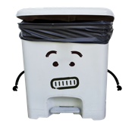
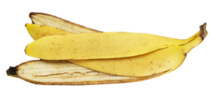
Why food waste matters
Introduction Option 2
___% of the average rubbish bin in Wales is made up of food waste – it should be 0!
Throwing away edible food costs the average Welsh household £___ a month.
___ recycled banana peels would create energy to fully charge a tablet.
Want to find out more about the power of food waste? Try our fun Maths Mission!
Notes:
Introduction Option 2 – 5 mins (slide 6 of 7)
This slide is most suitable for Progression Step 3 pupils. If working with Progression Step 2 pupils, move to slide 17.
Ask students to work out each mental maths sum to answer each question.
Delivery note: If delivering as an assembly, ask for volunteers to answer. If delivering this session in class, ask pupils to work on them individually.
Click to reveal the answers.
Answers: 24%, £49, 3.5
Discuss the statements on the slide. Highlight that food waste should never go in the rubbish bin, which is why the answer to the second question is zero.

Slide 20

Why food waste matters
Introduction Option 2
24% of the average rubbish bin in Wales is made up of food waste – it should be 0!
Throwing away edible food costs the average Welsh household £49 a month.
3.5 recycled banana peels would create energy to fully charge a tablet.
Want to find out more about the power of food waste? Try our fun Maths Mission!
Notes:
Introduction Option 2 – 5 mins (slide 7 of 7)
This slide is most suitable for Progression Step 3 pupils. If working with Progression Step 2 pupils, move to slide 17.
Answers: 24%, £49, 3.5
Discuss the statements on the slide. Highlight that food waste should never go in the rubbish bin, which is why the answer to the second question is zero.

Slide 21
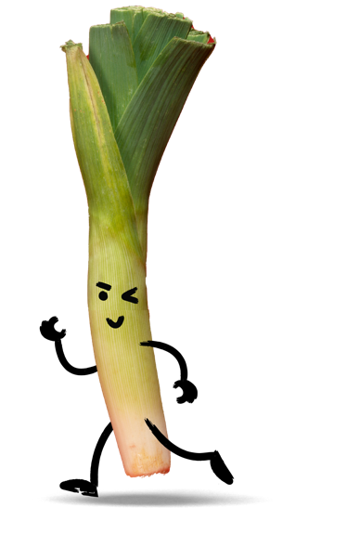

Slide 22

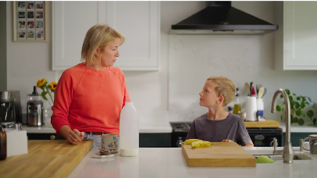

From kitchen caddy to renewable energy
Saving edible food
Listen carefully to the video
and answer these questions:
What extra fruit was added to the banana pancakes recipe to help use it up?
How else could you use up ripe fruit or vegetables?
These three items go in the caddy for recycling:
b_______ p____
e_________s
t____ b____
Notes:
Saving edible food – 3 mins (slide 1 of 2)​
Watch the YouTube video and ask pupils to listen out for the key points to help them fill in the missing gaps on the slide.​
Support: Stop the video midway through, if required, to allow pupils to answer the first set of questions.​
Click to reveal the answers on the next slide.
Banana pancake video URL: https://www.youtube.com/watch?v=gpguW8XWuPk

Slide 23
From kitchen caddy to renewable energy
Saving edible food
Listen carefully to the video
and answer these questions:
What extra fruit was added to the banana pancakes recipe to help use it up?
Raspberries were added to the banana pancakes recipe to help use them up.
How else could you use up ripe fruit or vegetables?
Fruit could be used up in smoothies, yoghurt, banana bread, home-made lollies, ice cream, cereal, bananas on toast, etc.
Vegetables could be added to pasta, an omelette, curry, soup, pizza, cheese on toast, stir fry, etc.
These three items go in the caddy for recycling:
banana peels
eggshells
tea bags
Notes:
Saving edible food – 3 mins (slide 2 of 2)​
Review the answers with pupils.
Banana pancake video URL: https://www.youtube.com/watch?v=gpguW8XWuPk

Slide 24
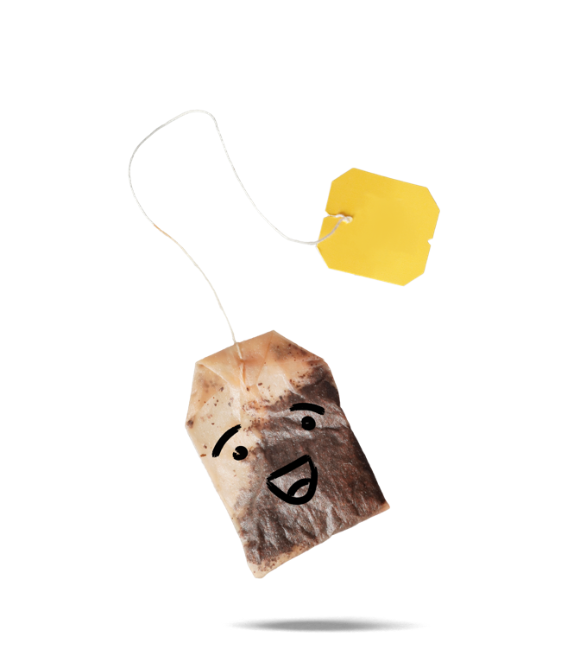

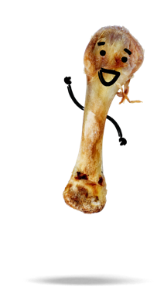
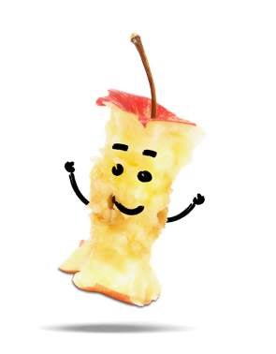
Notes:
Inedible food waste means = items of food that can't be eaten – like teabags, bones and apple cores.

Slide 25

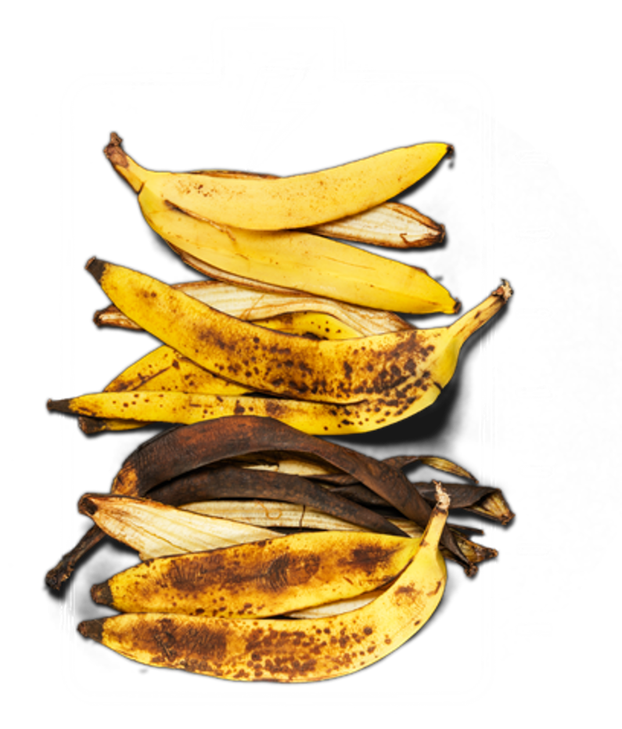
What can we do with inedible food waste?
Recycling inedible food
If you can't eat it, recycle it to help create renewable
energy to power your home and devices!
3 banana peels
could power 2 smartphones
When food waste is collected from your home, it's taken
to a special processing facility where it's recycled into
renewable energy.
Last year Welsh citizens recycled enough food waste to power over 10,000 homes! And just a single caddy of food waste
can power a home for an hour.
Did you know that Wales is the world's 3rd best recycling nation?
By recycling all our food waste we could get Wales to no.1.
1 pumpkin shell creates enough energy to power a home for an hour
Want to find out what your food waste can power?
Try our Power up challenge activity.
Notes:
Recycling inedible food – 7 mins (slide 1 of 4)
Share the information on the slide.

Slide 26


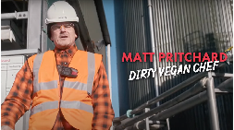
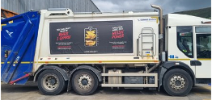
Did you know:
Food waste can be transformed into energy?
Recycling inedible food: The science
During anaerobic digestion, bacteria breaks down food waste without oxygen.
As the bacteria consumes the
food waste, they give off biogas (mostly methane).
The biogas is a versatile fuel that can power homes, schools, businesses and vehicles.
Last year we recycled enough food waste to power 10,000 homes for a whole year or 160 schools for an academic year.
Want to find out more about how anaerobic digestion helps create renewable energy?
Try our fun Science Mission experiment!
Notes:
Recycling inedible food – 7 mins (slide 2 of 4)
Watch the YouTube video and ask pupils to listen out for the key points.
https://www.youtube.com/watch?v=hw-Uhq6Z3fs
Microbe Magic experiment: www.walesrecycles.org.uk/schools

Slide 27





What can we feed the caddy?
Recycling inedible food
We have created these fun recipes to use up food at risk of being wasted!
For each of these recipes, what inedible food waste would you put in your food waste caddy?
Save a potato with a Jazzed-up pan omelette
      Eggs
      Potatoes
      Onion
      Milk
      Peas
Save a banana with
a Yoghurt sundae
      Yoghurt
      • Banana
      Strawberries
      Apple
      Granola
Save chicken with
Roast chicken fajita
      Chicken
      Peppers
      Carrots
      Fajita seasoning
      Tortilla wraps
Save a leek with
a One-pot pasta
      Pasta
      Tinned chopped tomatoes
      Onion
      Garlic
      Leek
Notes:
Recycling inedible food – 7 mins (slide 3 of 4)
Discuss the question on the slide as a class or complete as a Think, Pair, Share activity.
Click to reveal the answers.
Jazzed-up pan omelette: eggshells, onion skin
Yoghurt sundae: strawberry stalks, apple core
Roast chicken fajita: chicken bones, carrot tops, pepper core
One-pot pasta: garlic skins, root end of leek
Discuss how AVOIDABLE food waste might be created, e.g.:
not using ingredients before their expiry date
serving too much food and then wasting it
forgetting to refrigerate/freeze leftovers
not planning how to use food items.

Slide 28
What can we feed the caddy?
Recycling inedible food
We have created these fun recipes to use up food at risk of being wasted!
For each of these recipes, what inedible food waste would you put in your food waste caddy?
Save a potato with a Jazzed-up pan omelette
      Eggs
      Potatoes
      Onion
      Milk
      Peas
Save a banana with
a Yoghurt sundae
      Yoghurt
      • Banana
      Strawberries
      Apple
      Granola
Save chicken with
Roast chicken fajita
      Chicken
      Peppers
      Carrots
      Fajita seasoning
      Tortilla wraps
Save a leek with
a One-pot pasta
      Pasta
      Tinned chopped tomatoes
      Onion
      Garlic
      Leek
Answers:
Eggshells
Onion skin
Answers:
Strawberry stalks
Apple core
Answers:
Chicken bones
Carrot tops
Pepper core
Answers:
Garlic skins
Root end of leek
Notes:
Recycling inedible food – 7 mins (slide 4 of 4)
Discuss the question on the slide as a class or complete as a Think, Pair, Share activity.
Click to reveal the answers.
Jazzed-up pan omelette: eggshells, onion skin
Yoghurt sundae: strawberry stalks, apple core
Roast chicken fajita: chicken bones, carrot tops, pepper core
One-pot pasta: garlic skins, root end of leek
Discuss how AVOIDABLE food waste might be created, e.g.:
not using ingredients before their expiry date
serving too much food and then wasting it
forgetting to refrigerate/freeze leftovers
not planning how to use food items.

Slide 29
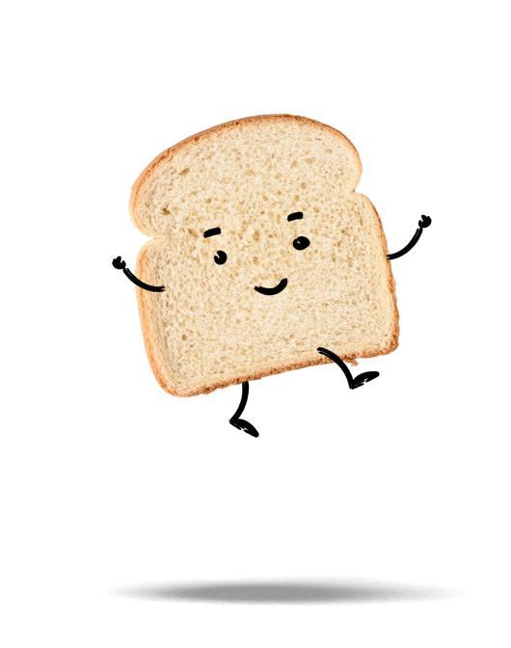

Slide 30
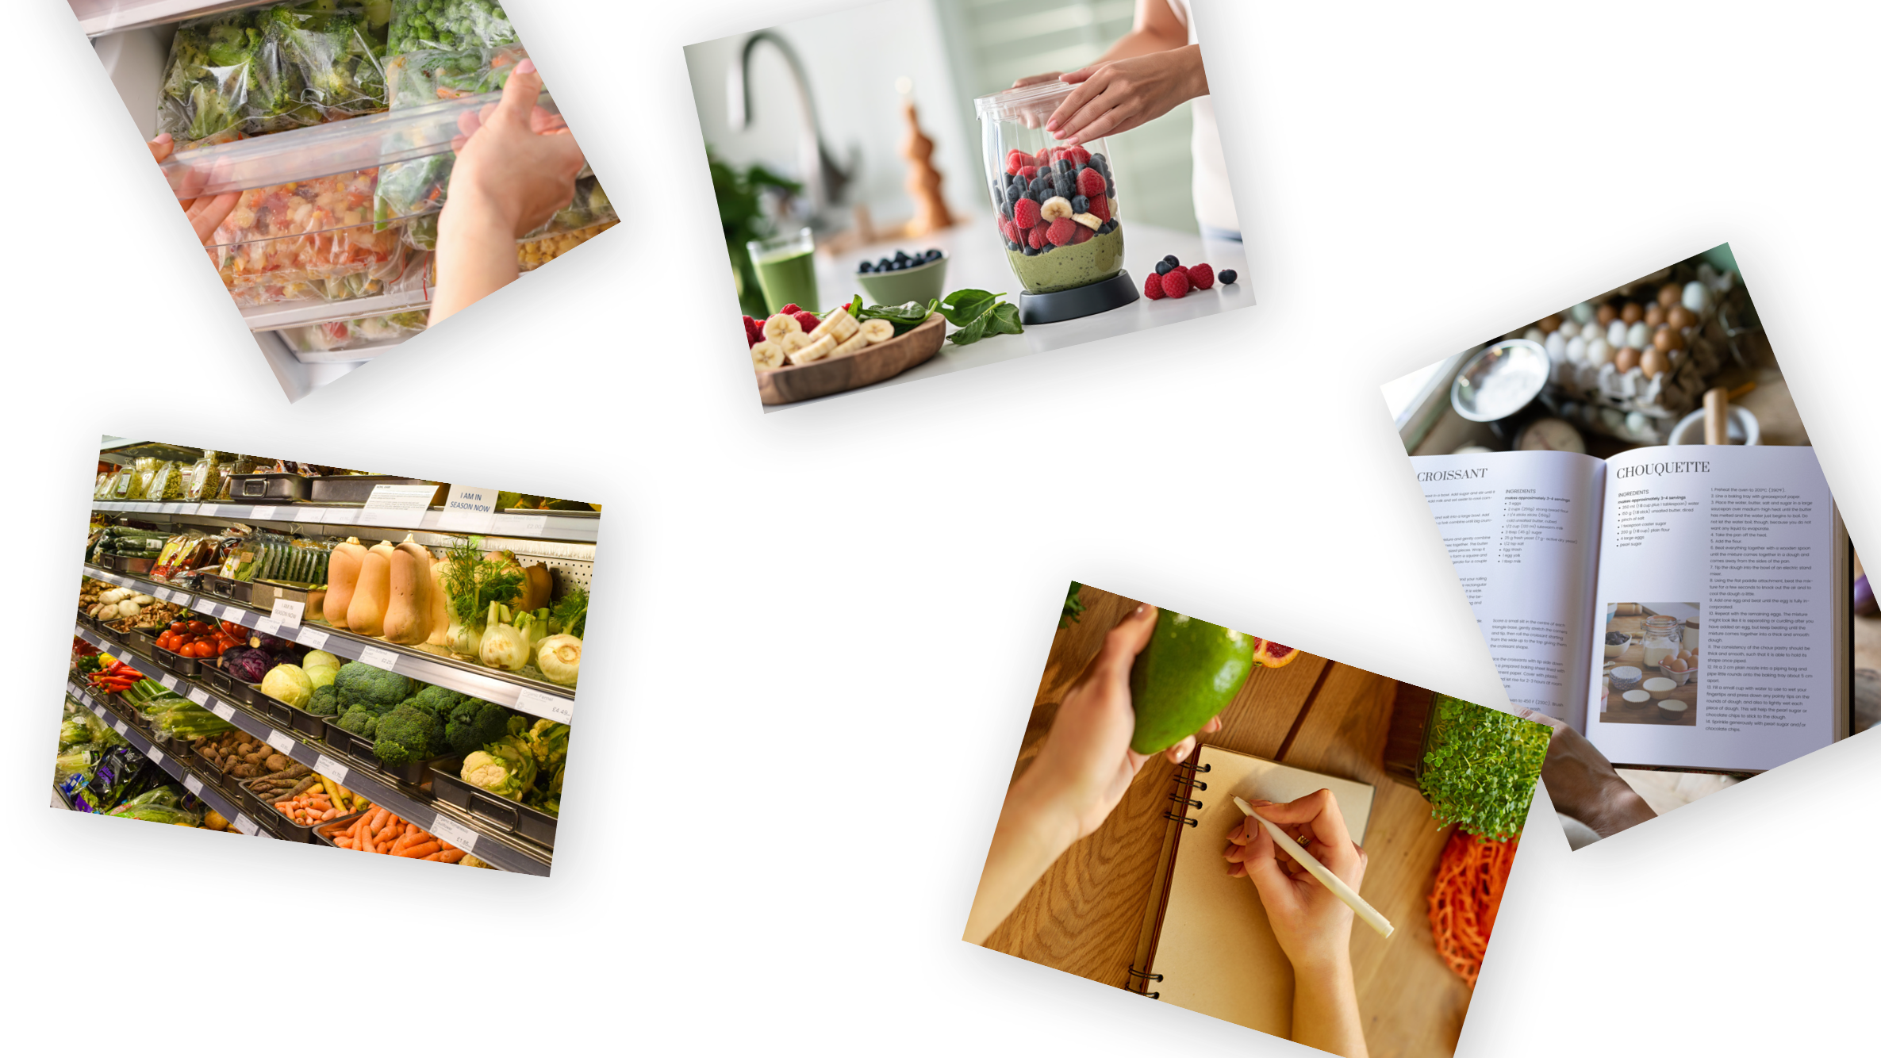
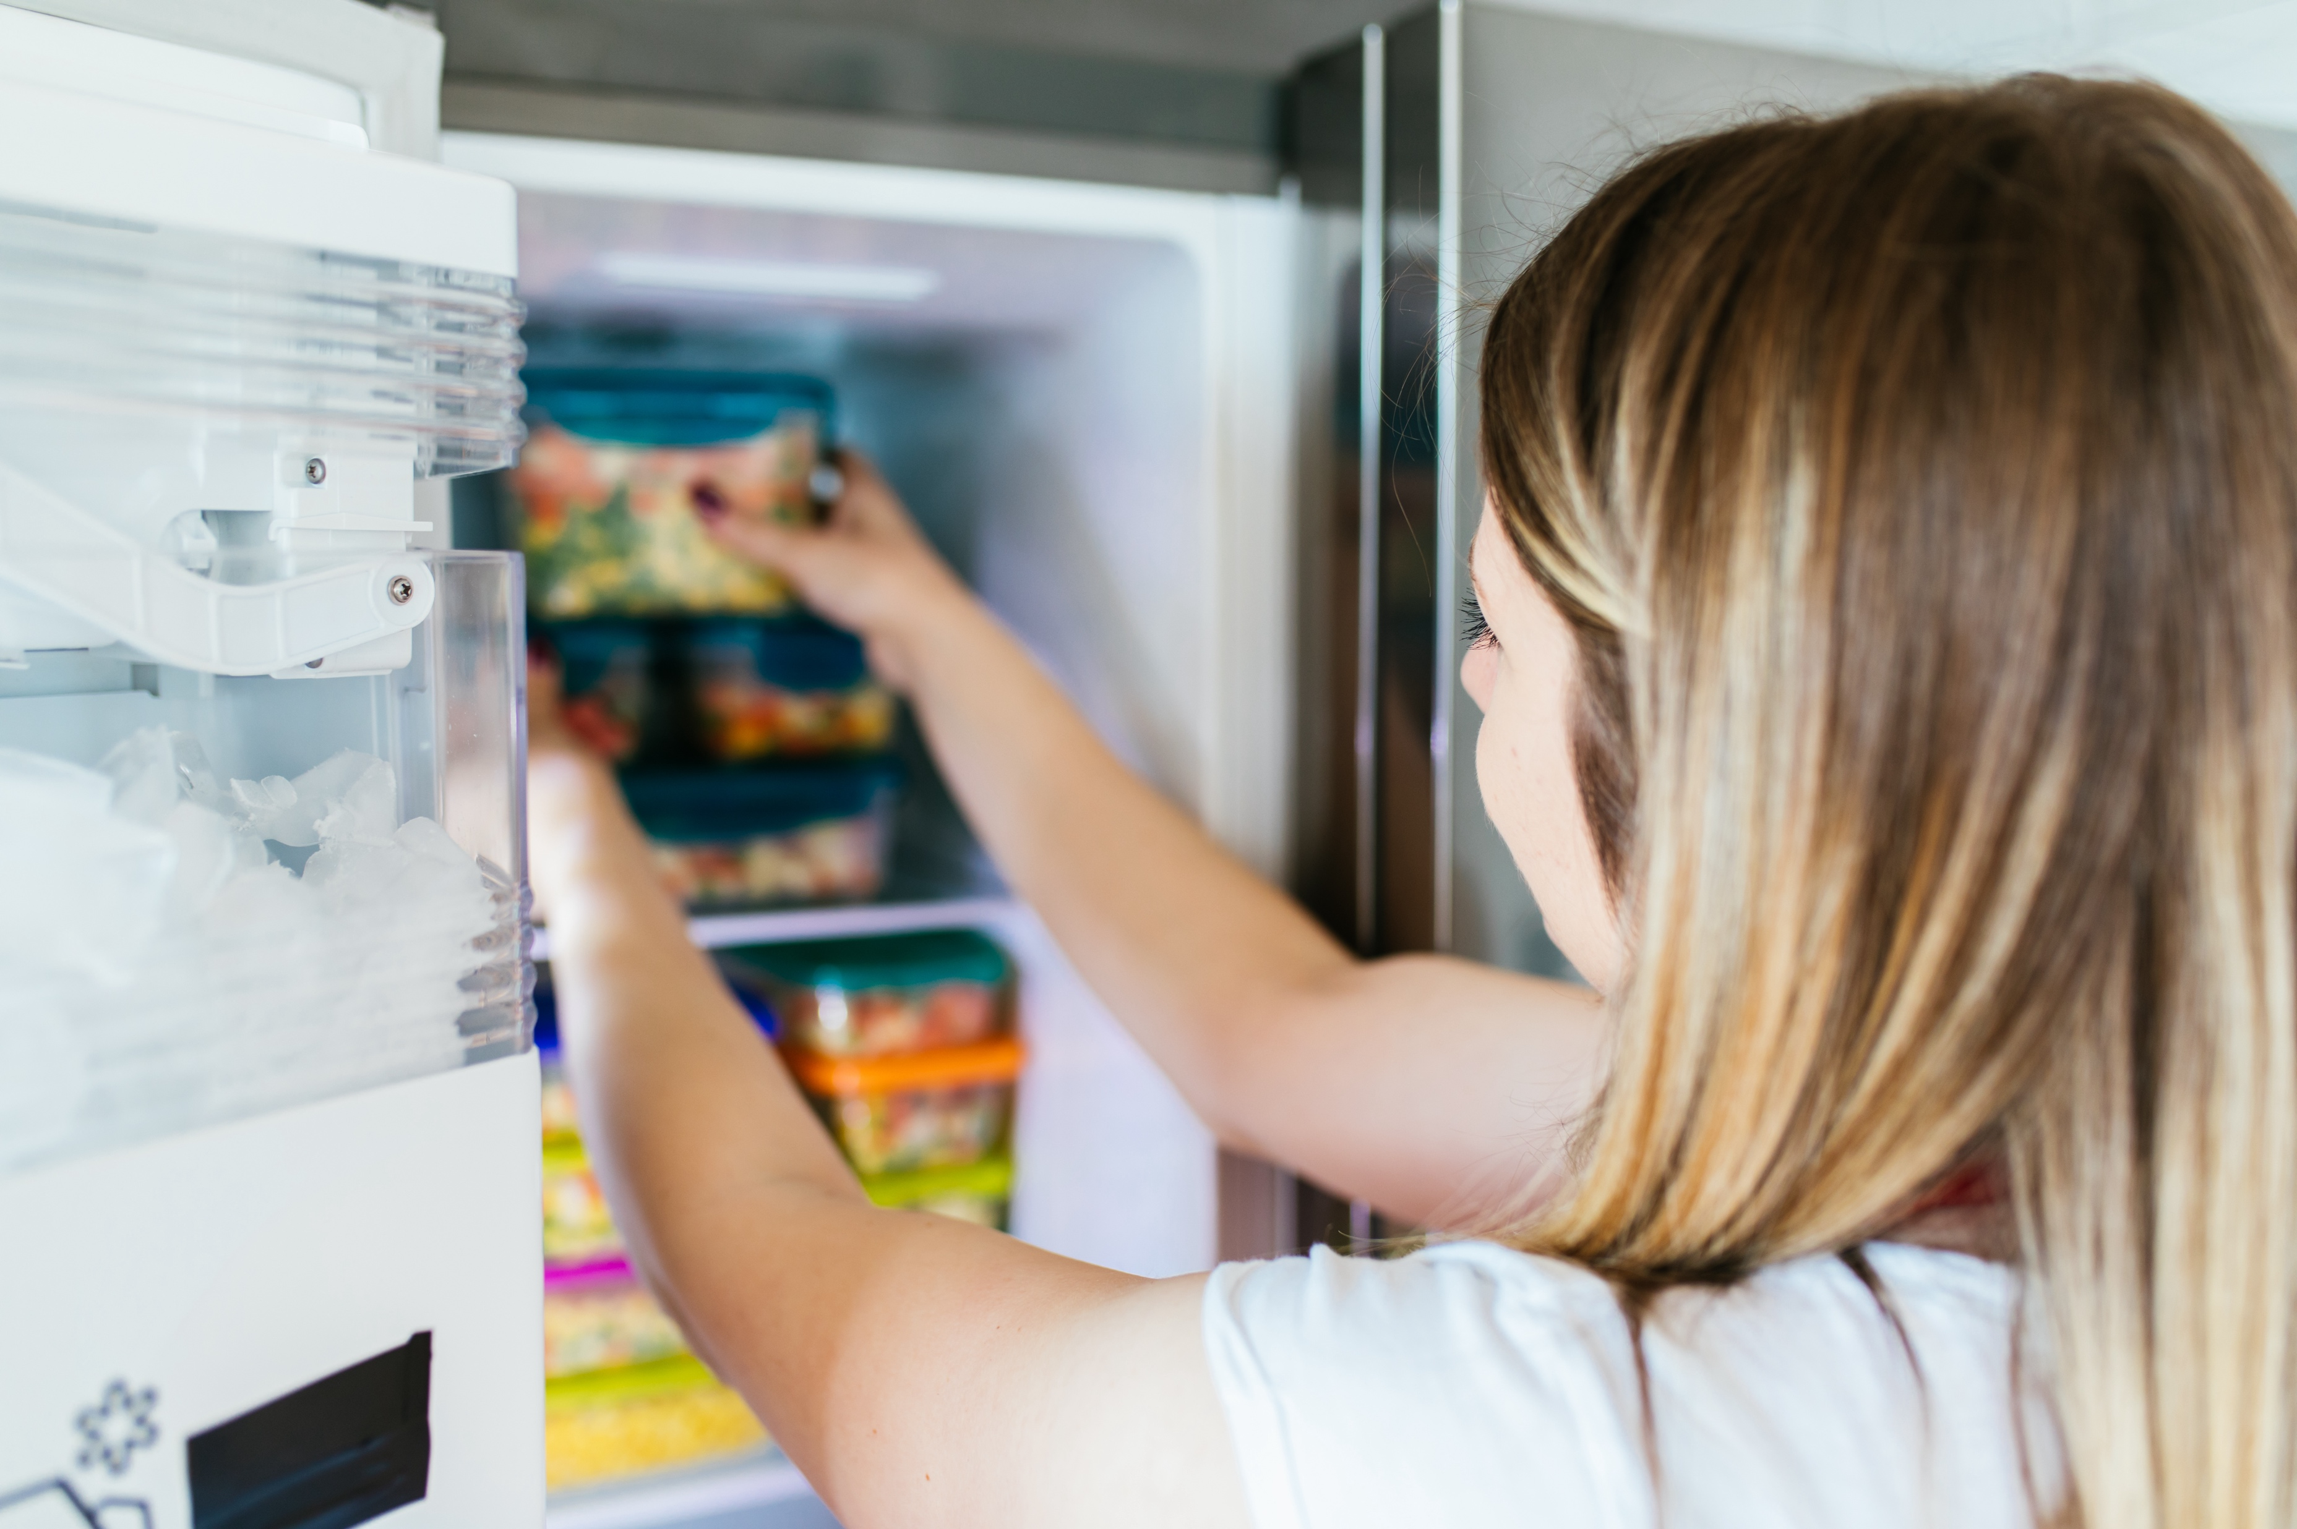
Ways to avoid waste
Want to get creative and share
what you’ve learned? Try our fun
Languages and Literacy Mission!
Notes:
Plenary – 5 mins (slide 1 of 3)
Ask pupils if they can think of any ways in which food waste can be avoided. Take suggestions from the class.
Example:
Planning – thinking ahead about what meals you might have
Shopping – buying exactly what you need
Storage – storing food correctly in the fridge, freezer or cupboard
Meal preparation – using up food in meals, e.g. a leftover banana in a smoothie

Slide 31

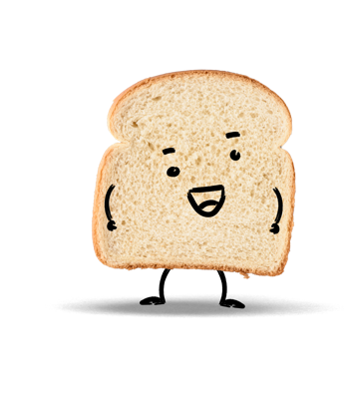
Can I really make a difference?
Plenary
Every action has a consequence! Your everyday choices
can help protect our planet –
and save money!
Question:
What does it mean to be an active citizen?
Notes:
Plenary – 5 mins (slide 2 of 3)​
Ask pupils the question on the slide.​
Click to reveal the answer.​
Discuss how tackling food waste makes pupils active citizens.

Slide 32

Can I really make a difference?
Plenary
Every action has a consequence! Your everyday choices
can help protect our planet –
and save money!
Question:
What does it mean to be an active citizen?
Answer:
Active citizens learn about the challenges that face our planet
and take action
to help make
a difference.
Notes:
Plenary – 5 mins (slide 3 of 3)​
Ask pupils the question on the slide.​
Click to reveal the answer.​
Discuss how tackling food waste makes pupils active citizens.

Slide 33
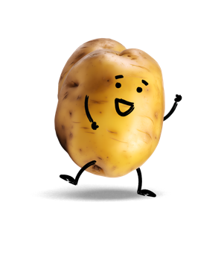

Slide 34
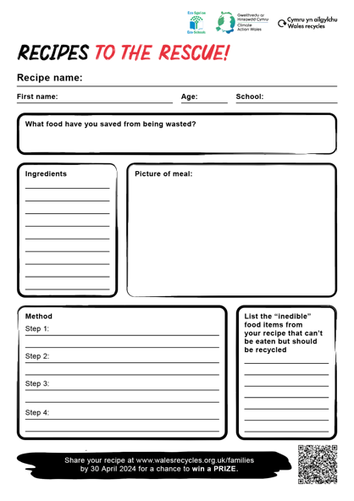

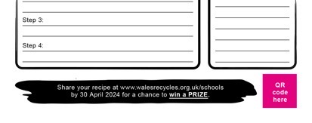
Your mission
Competition intro
Help get people to make the
most of food and do their bit
to make Wales the mightiest recycling nation!
We are asking children
aged 5 to 11 to come up
with ideas for healthy,
delicious recipes that turn commonly wasted foods
into feasts!
Create a recipe poster
to share your idea.
Notes:
Competition intro – 5 mins+ (slide 1 of 4)
Use the recipe poster template sheet to complete this activity.
Don’t forget to submit any completed work into the competition here: www.walesrecycles.org.uk/schools
Children and their families can take part in the competition by entering a recipe poster of their dish made from food they already have at home. The best entry will win a food hamper for the child's family and books worth £50 for their school!

Slide 35

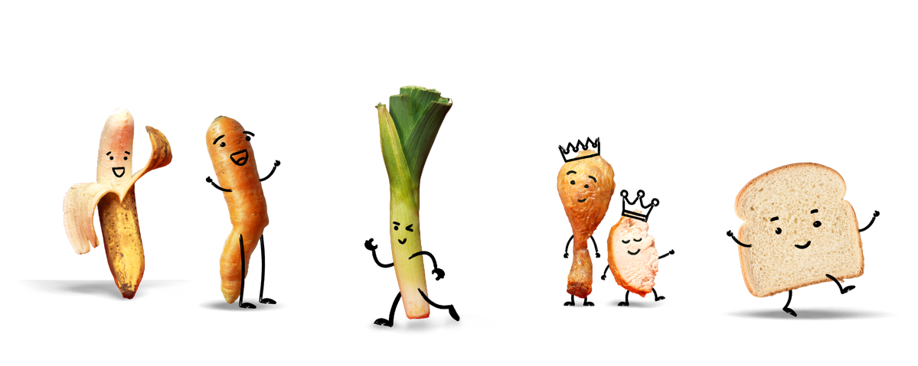
First, choose something at risk of being wasted
Competition intro
Think about which food item is sometimes
wasted in your home or choose one of these
items that is commonly wasted.
Notes:
Competition intro – 5 mins+ (slide 2 of 4)
Review the most commonly wasted foods and ways in which they might be able to be rescued from the food waste bin.
Display this slide while pupils are completing the competition activity.

Slide 36

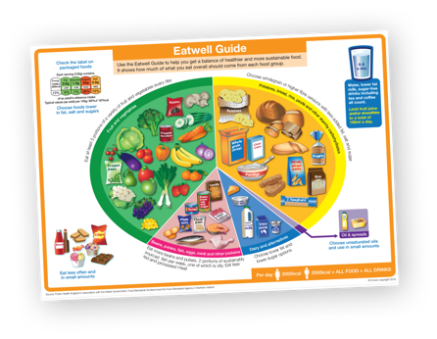
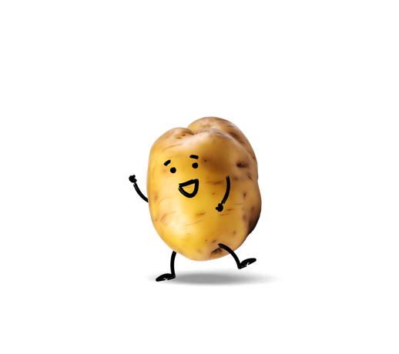
Next, think about exciting ways to use it up
Competition intro
Brainstorm other recipe ideas
for your chosen item.
Look at the Eatwell plate to make
your recipe as balanced as possible.
Still stuck for ideas? Adapt one of our recipes from our Be Mighty inspiration gallery!
Notes:
Competition intro – 5 mins+ (slide 3 of 4)
Once pupils have selected their chosen food item, encourage them to brainstorm ideas of different meals or snacks that could be made using that item.
Look at the Eatwell plate to understand what makes a balanced meal.
https://www.nhs.uk/live-well/eat-well/food-guidelines-and-food-labels/the-eatwell-guide/

Slide 37
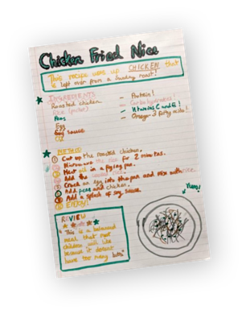
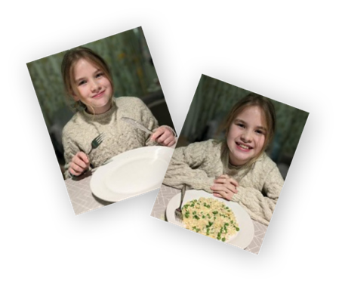
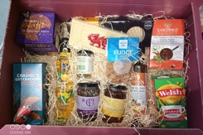


Finally, create your poster and share it with us!
Competition intro
Ask a parent or carer to visit www.walesrecycles.org.uk/
families and send a photo
of your recipe
If you actually make your recipe, send us photos! (optional)
Enter today to get a chance
of winning some great prizes:
A hamper worth £50 full
of your favourite healthy food
£50 worth of books
for your school
The competition deadline is 30 April 2024
Notes:
Competition intro – 5 mins+ (slide 4 of 4)
Use the recipe poster template sheet to complete this activity.
Don’t forget to submit any completed work into the competition here: www.walesrecycles.org.uk/families
Children and their families can take part in the competition by entering a recipe poster of their dish made from food they already have at home. The best entry will win a food hamper for the child's family and books worth £50 for their school!

Slide 38
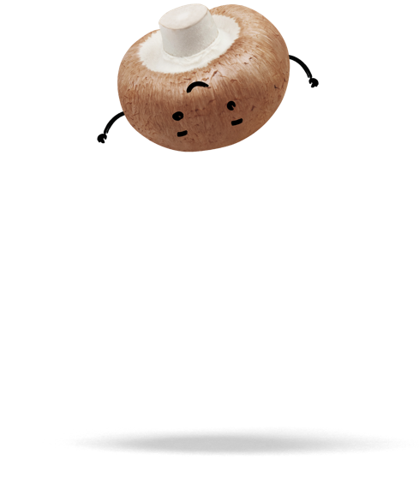
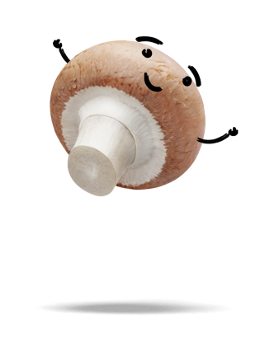
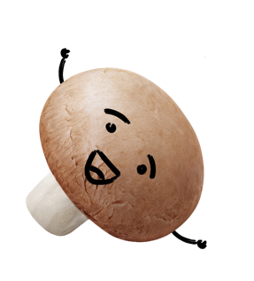

Slide 39
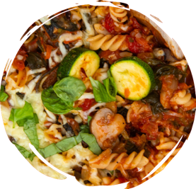

How could you adapt this recipe?
The Be Mighty recipe inspiration gallery
One pot pasta – serves 2
This easy and quick meal lets you throw in anything you have in the fridge.
There are lots of ways you can personalise it for your family!
Method
Step 1: Boil your pasta as per packet instructions. While it is boiling, proceed to step 2.
Step 2: Fry the pepper, carrots
and mushrooms in a tablespoon
of oil, until soft.
Ingredients
      160g pasta
      One pepper, diced
      Two carrots, grated
      Handful of mushrooms, sliced
      Tablespoon of olive oil
      One tin of chopped tomatoes
Step 3: Add the chopped
tomatoes and heat through,
then mix in your cooked
pasta and serve.
Notes:
The Be Mighty recipe inspiration gallery – 5 mins (slide 1 of 3)
For added support, review this recipe for a one pot pasta.
Ask pupils what ingredients could potentially be swapped for something else.
Discuss the easy swaps that might help save food at risk of being wasted.

Slide 40

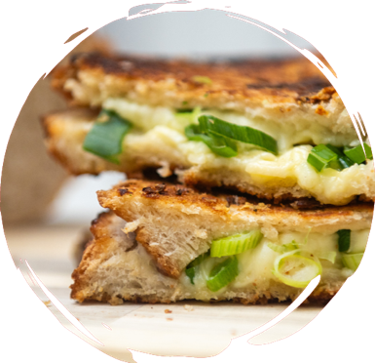
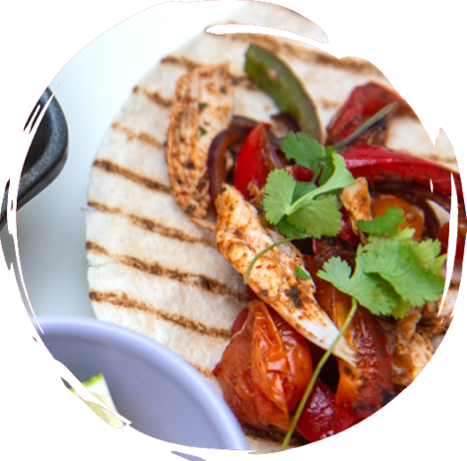

Or one of these?
Roast chicken fajita
      Spice up leftover roast chicken and vegetables.
      Fry mushrooms, tomatoes, peppers, spinach,
      grated carrot or any vegetables in a pan.
      Season with your preferred favourite fajita spices.
      Add the leftover chicken and heat thoroughly until hot.
      Enjoy in a wrap or on a jacket potato.
Epic cheese toastie
      Decorate leftover bread with exciting toppings.
      Add any vegetables such as tomatoes or leeks, cooked meat or ham, or even a spoon of leftover curry or chili to your favourite cheese filling.
      Serve with any salad items from your fridge.
Notes:
The Be Mighty recipe inspiration gallery – 5 mins (slide 2 of 3)
Review these extra recipe ideas to support pupils with idea generation.
Each of these recipes has easy swaps that can be made.

Slide 41

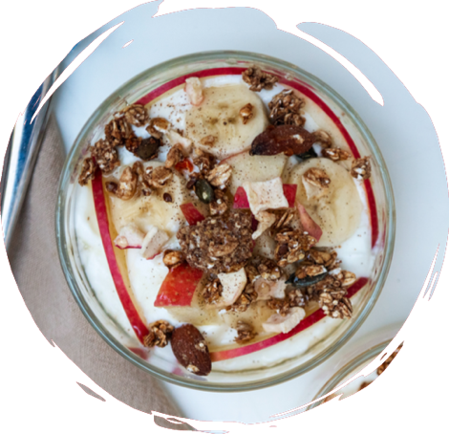


Or one of these?
Jazzed-up pan omelette
      Use up eggs and potatoes in this tasty dish.
      Fry your favourite vegetable fillings in a non-stick pan until soft.
      Add boiled potato slices (leaving the skin on).
      Add your whisked egg and season.
      Sprinkle cheese and grill until golden brown.
Yoghurt sundae
      Get creative with the last pieces of fruit.
      Layer thinly sliced banana, apple or any fruits that need using up, with yoghurt.
      Sprinkle with crunchy granola or crushed up biscuits and a drizzle of honey.
Notes:
The Be Mighty recipe inspiration gallery – 5 mins (slide 3 of 3)
Review these extra recipe ideas to support pupils with idea generation.
Each of these recipes has easy swaps that can be made.

Slide 42
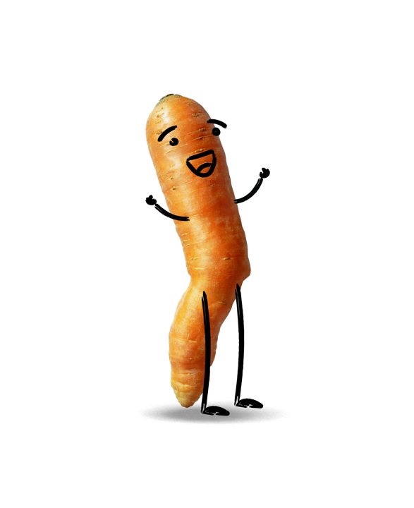

Slide 43

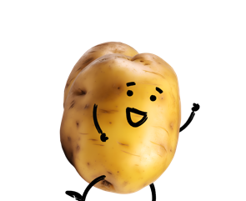
What recipes did you create?
Reviewing your recipes
Bring your recipes into class so you can share
your ideas and inspire each other!
Remember, the best thing we can do with
inedible food waste is recycle it. But it’s best
for our bank balance and our planet if we
eat ALL of our edible food!
How else can you help everyone in your community to get the most value out of the food we buy?
Idea! You could compile all the recipes
into a class recipe book and share it with
people at home!
Notes:
Reviewing your recipes – 5–10 mins (slide 1 of 1)
Review the different ways pupils can spread the word.
Make a class action plan to decide which options the class will do.

